Slide 1
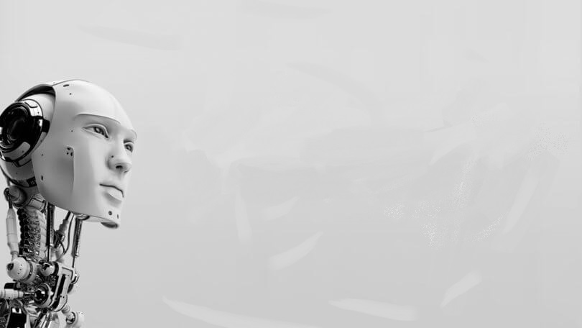
The evolution of Ai
And what may comes next

Slide 2

The beginning of AI
AI's captivating history traces back to ancient myths. Its formal pursuit started in 1956, leading to rule-based systems and the first 'AI winter.' In the 1980s, AI resurged with machine learning breakthroughs, like neural networks and deep learning. Today, AI drives innovations across industries, with a promising future ahead.

Slide 3
Introduction to AI
1. Definition of AI
2. Types of AI
3. Applications of AI
4. Importance of AI

Slide 4
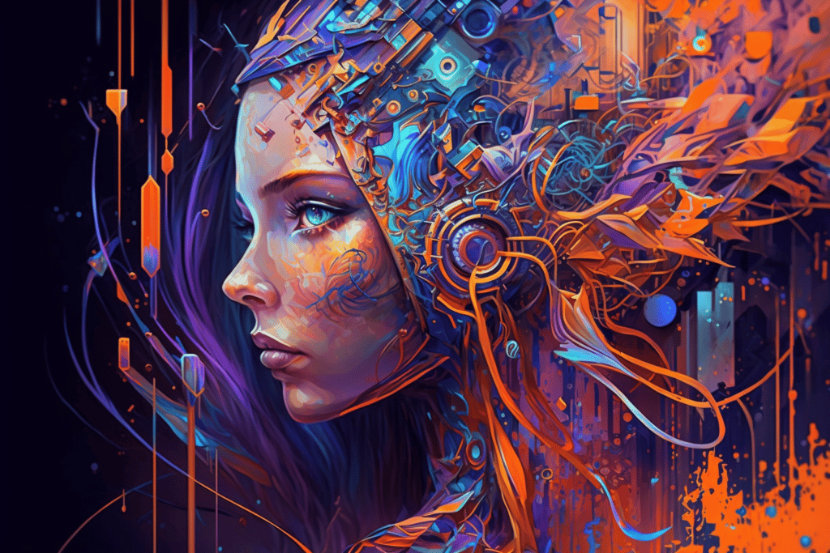
Art generated by AI

